Slide 1


UNISON
From untruth, lead us to Truth
From the darkness, lead us to the Light
From death, to immortality
Asatoma Sadgamaya
Tamasoma Jyotirgamaya
Mrityorma Amritangamaya
Om Shanti Shanti Shantihi
Next: May All The Beings

Slide 2
UNISON
May All The Beings In All The Worlds Have Happiness And Peace
Samastha Lokah
Sukhino Bhavantu (3X)
Om Shanti Shanti Shantihi!
Next: Meditation

Slide 3
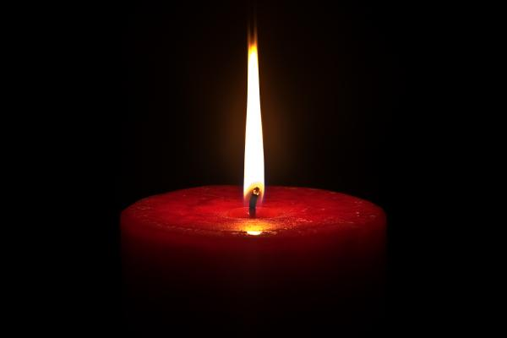
Meditation
ૐ
Silent Departure
Silent Departure……

Slide 4
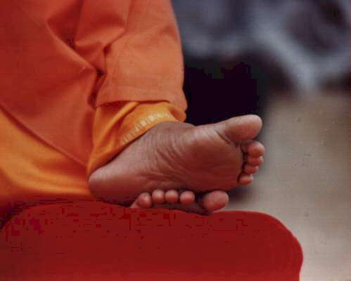
Love All & Serve All

